Slide 1
ABC’s of Nature
By: Sherri the Outdoor Adventurer

Slide 2
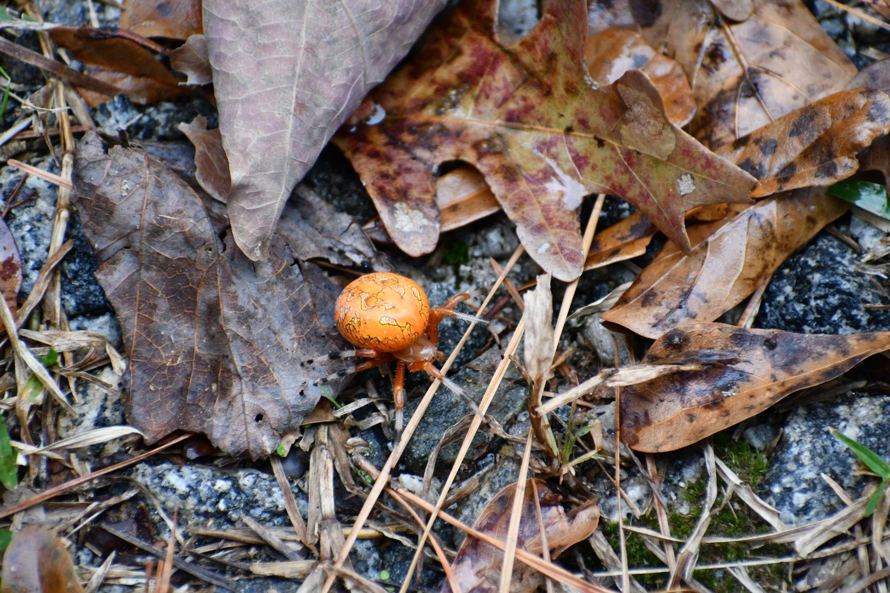
A
Arachnid

Slide 3
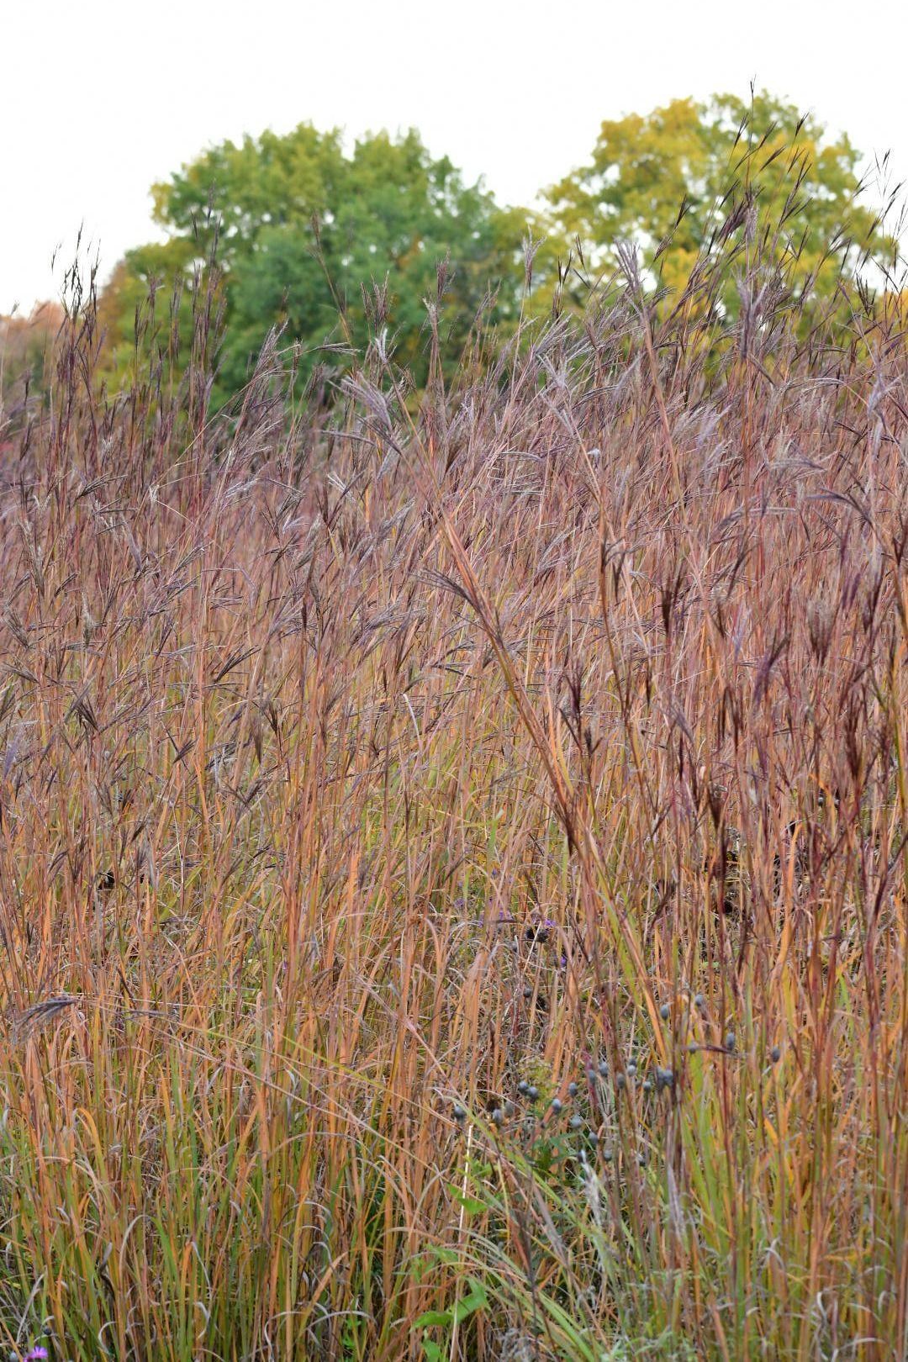
Big Bluestem
B

Slide 4
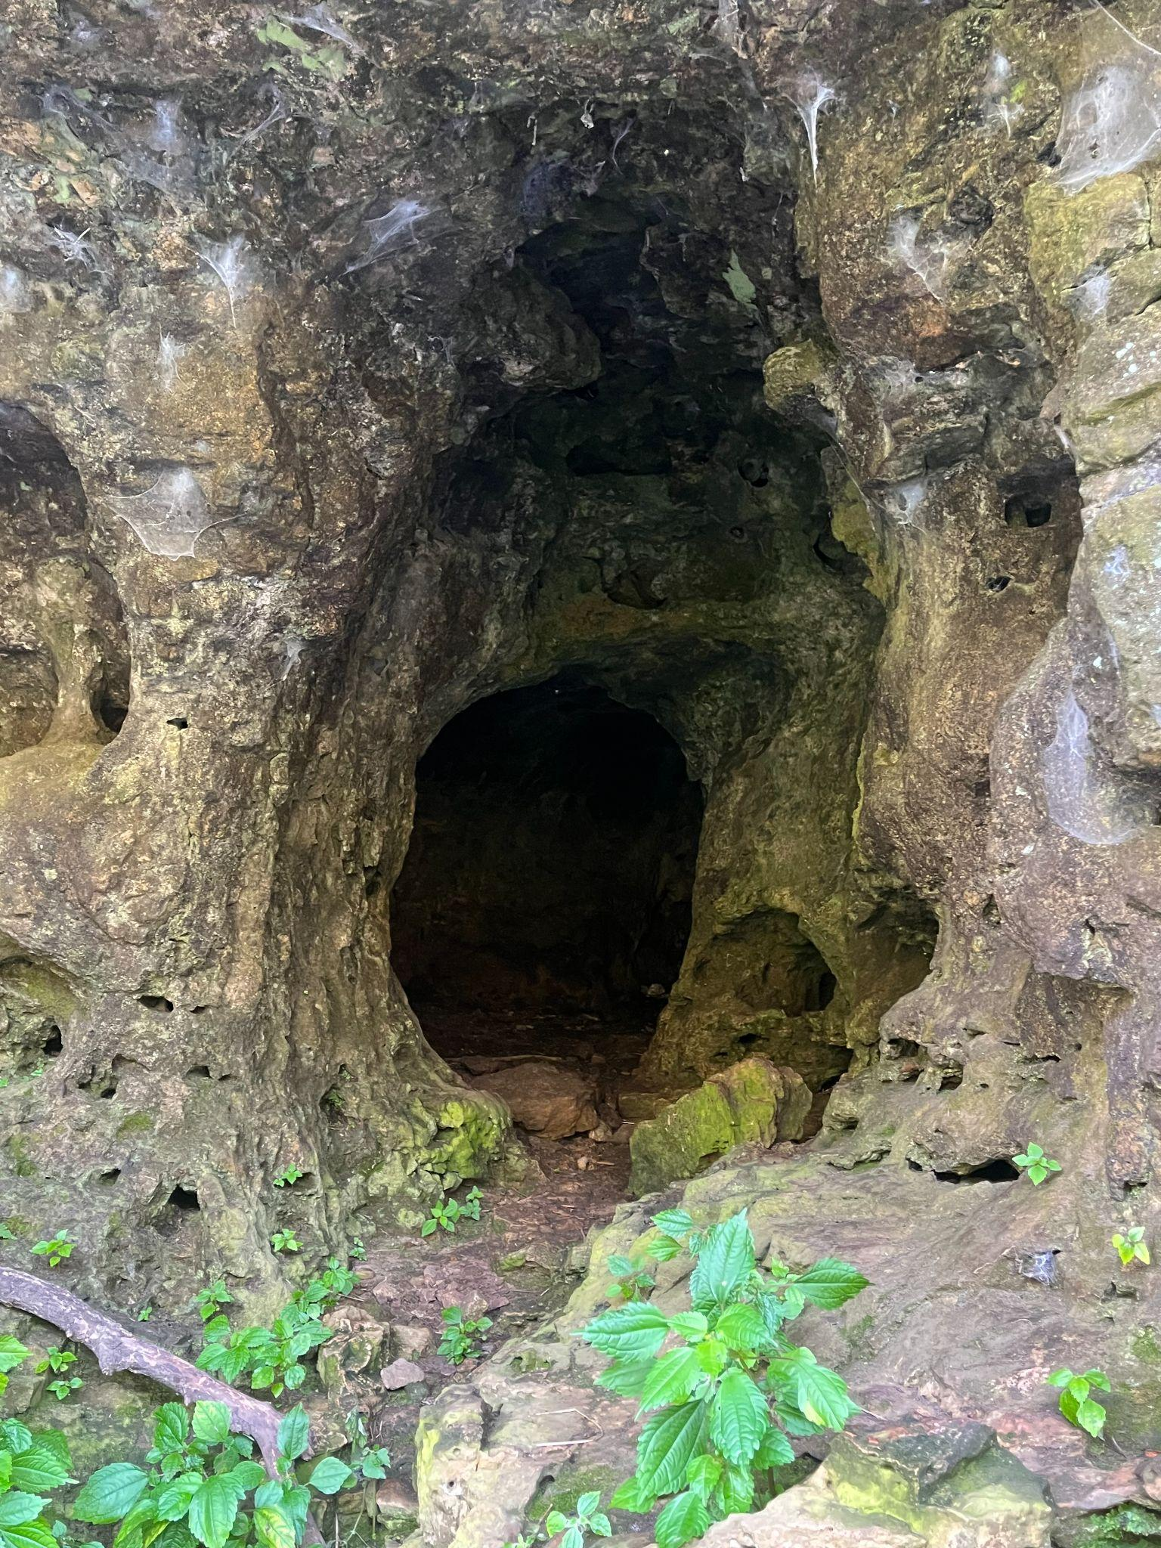
C
Cave

Slide 5
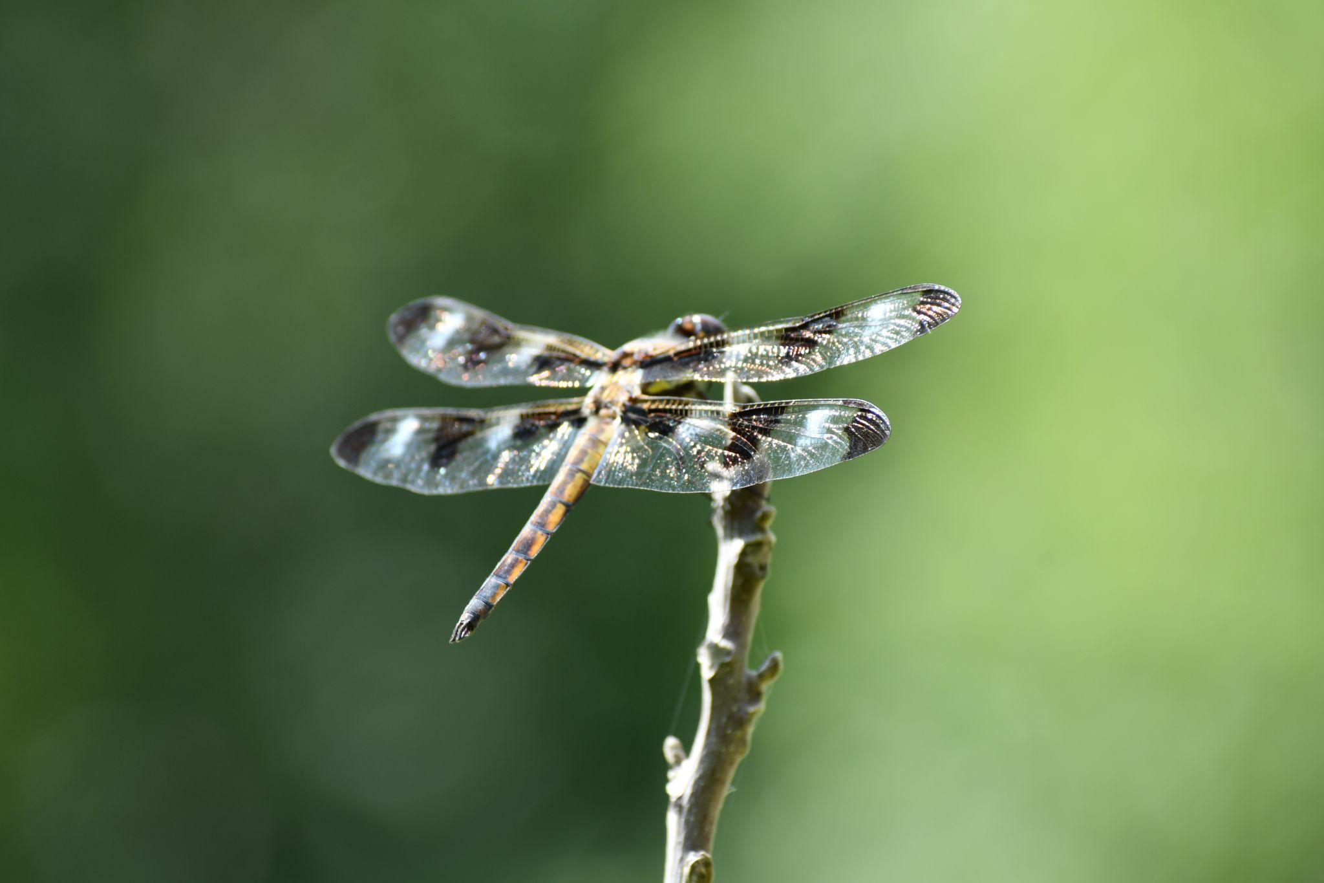
D
Dragonfly

Slide 6
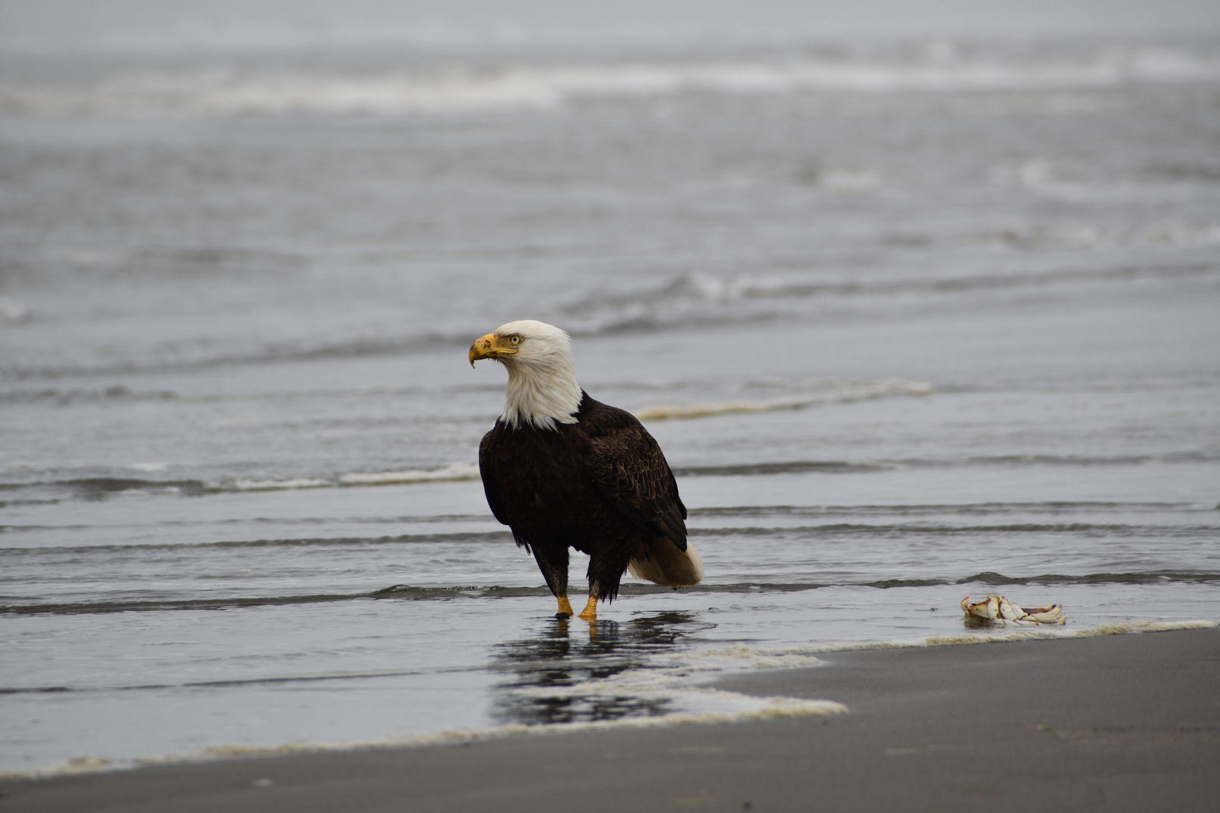
E
Eagle

Slide 7
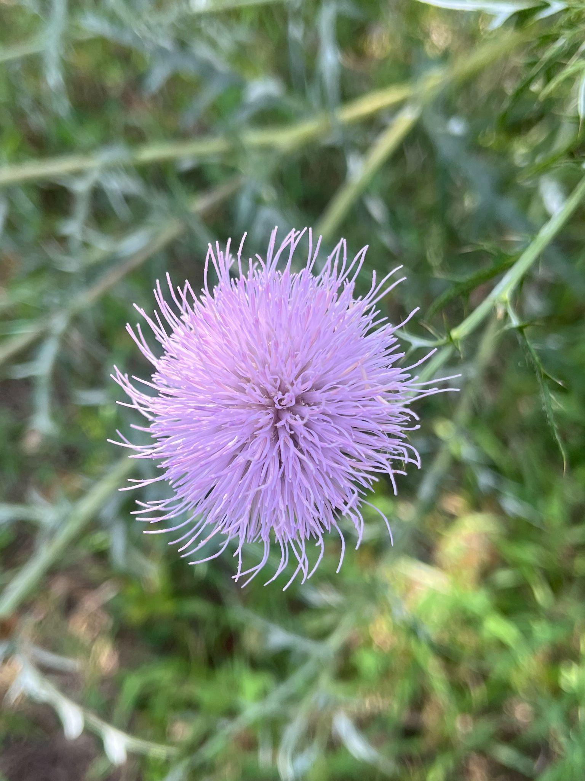
F
Flower

Slide 8
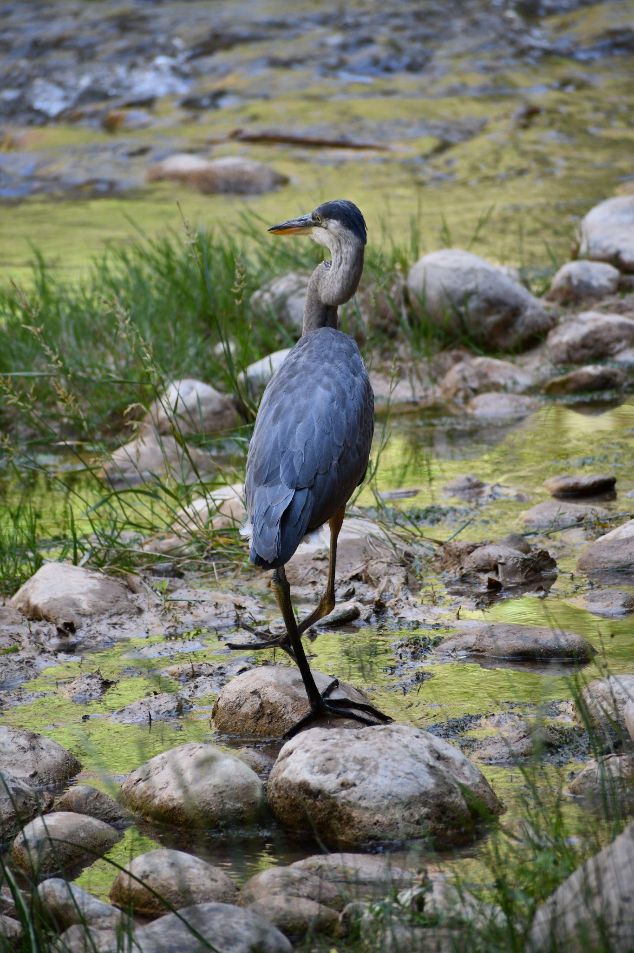
G
Great Blue Heron

Slide 9
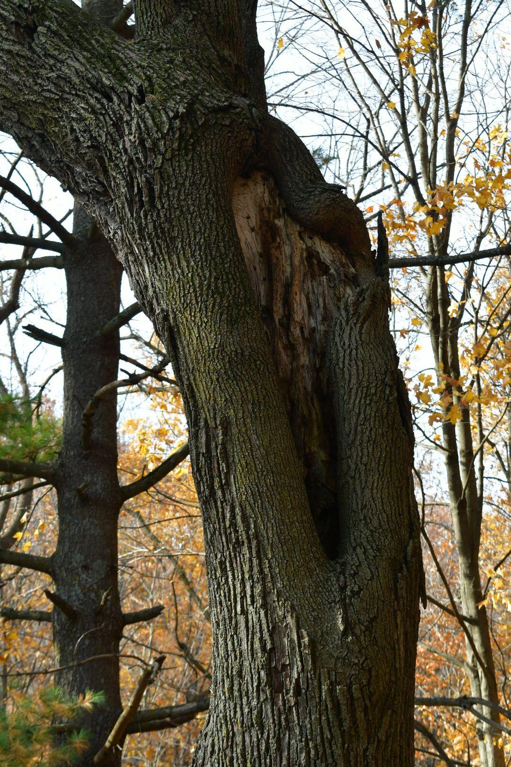
H
Hole

Slide 10
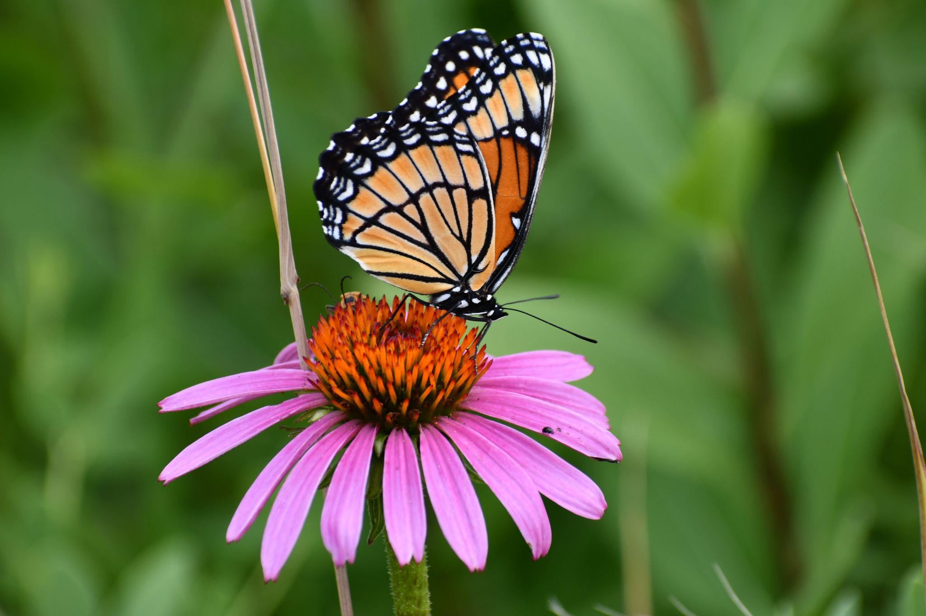
I
Insect

Slide 11
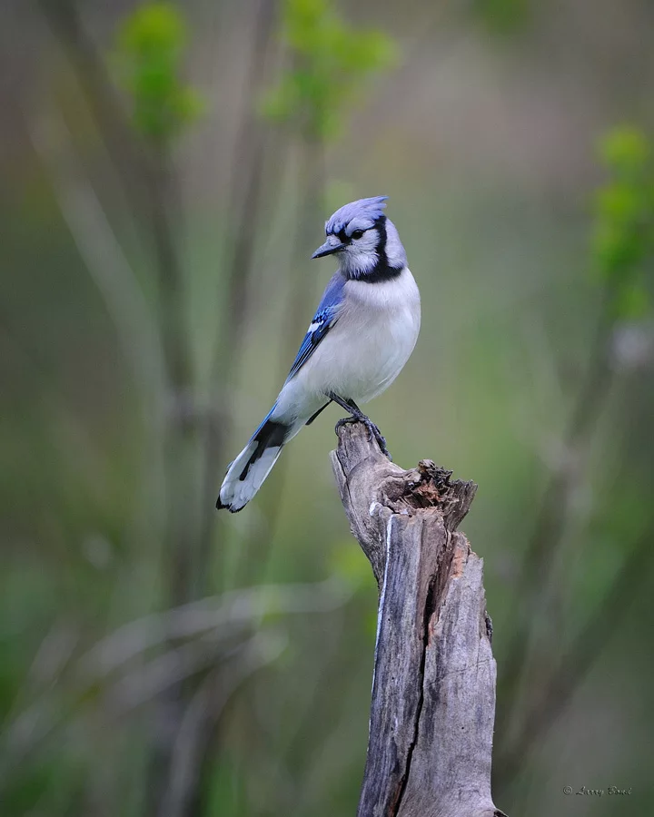
J
Jay

Slide 12
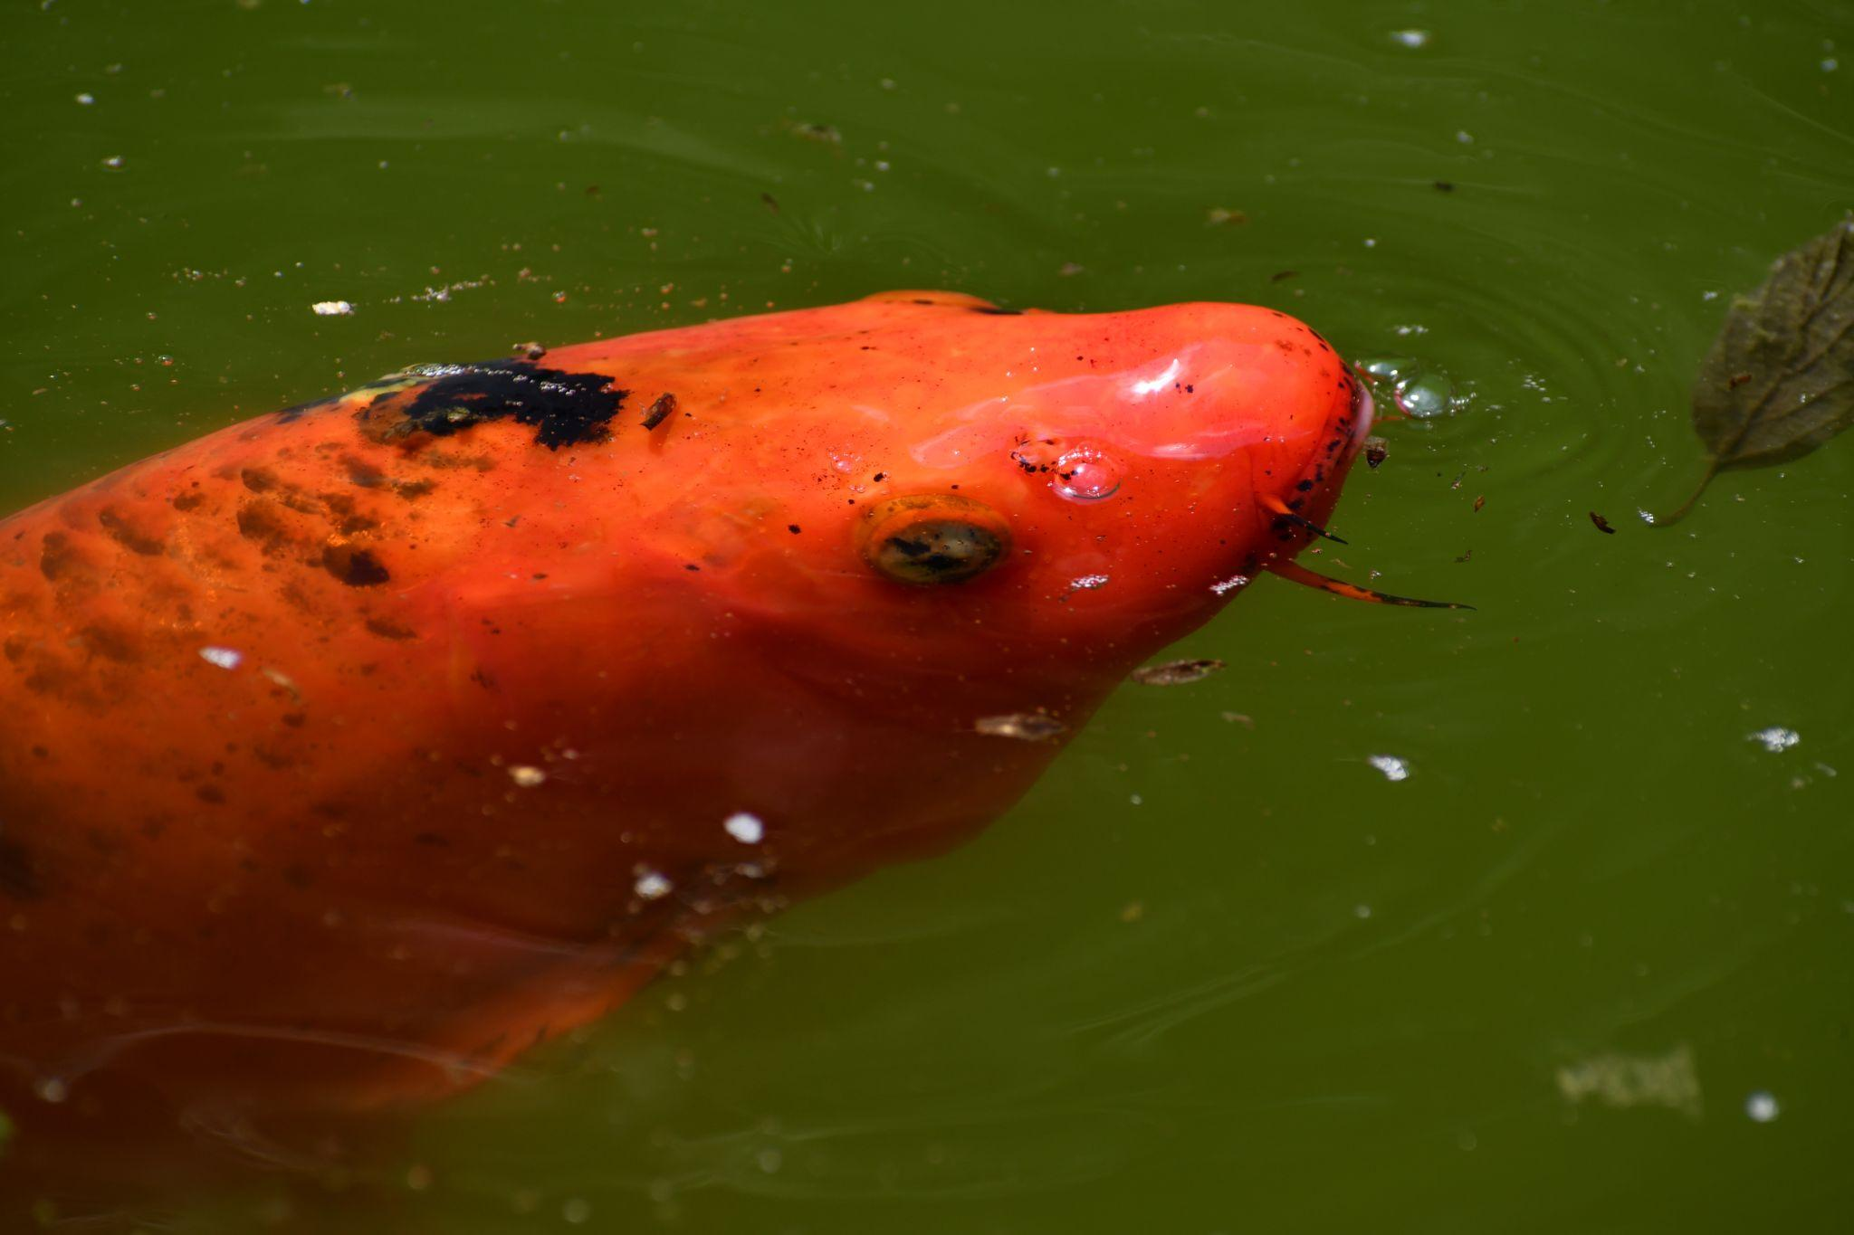
K
Koi

Slide 13
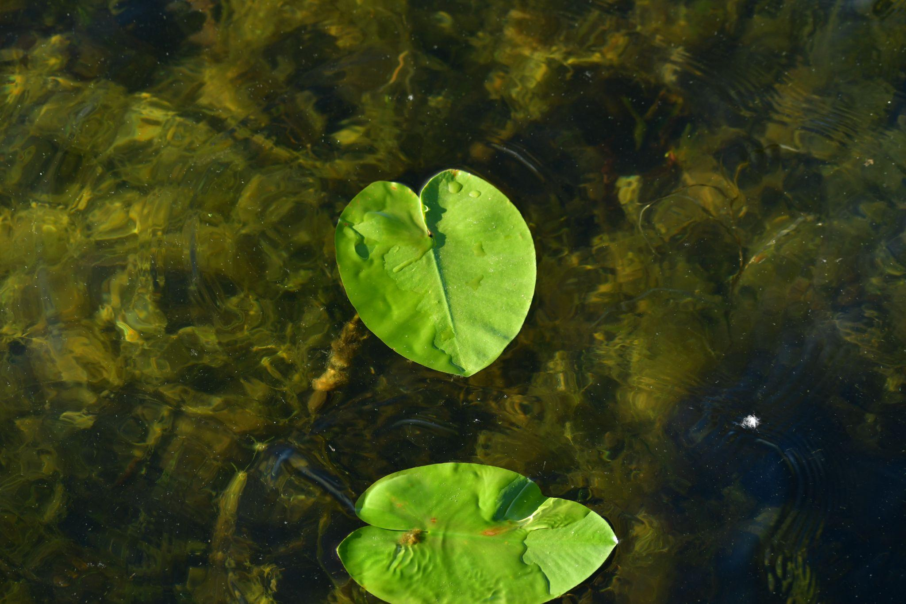
L
Lily pad

Slide 14
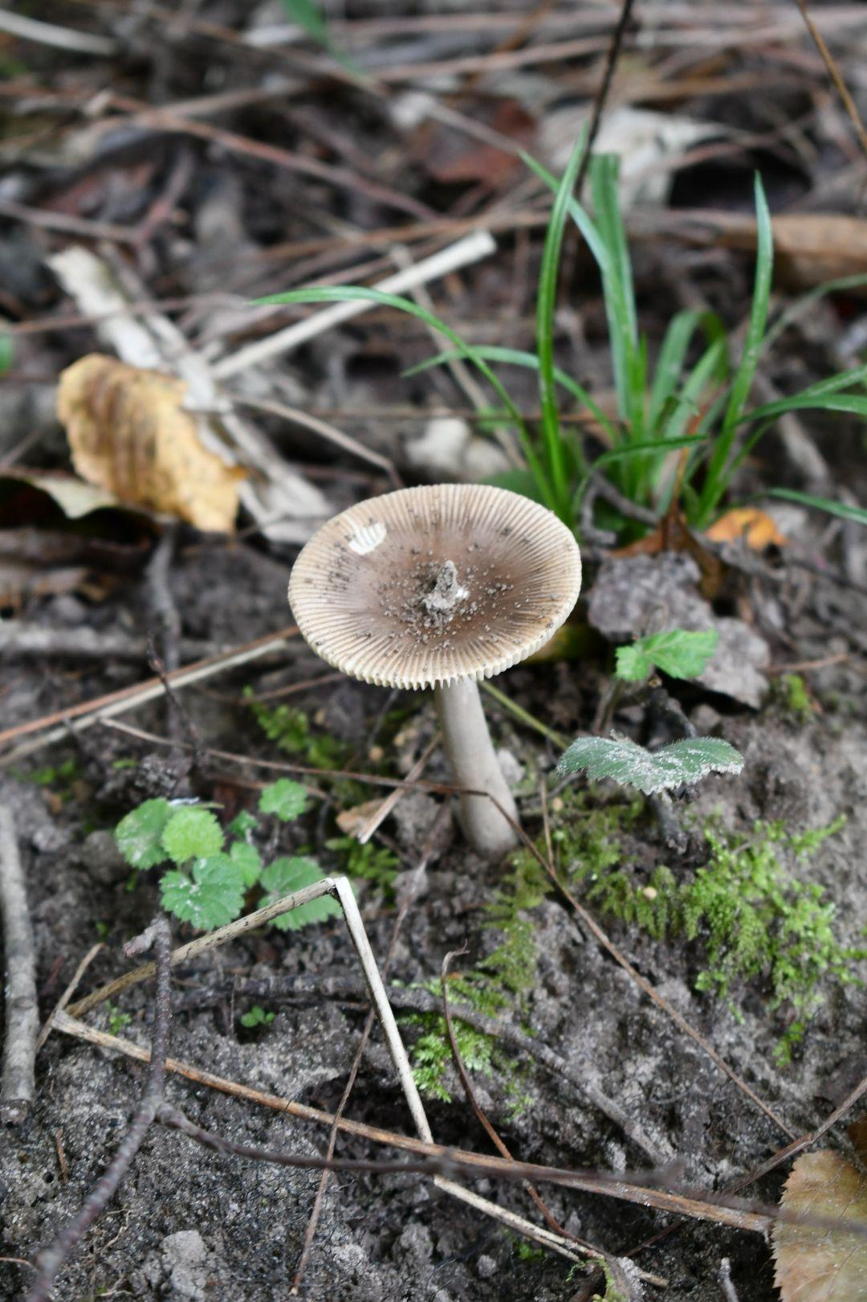
M
Mushroom

Slide 15
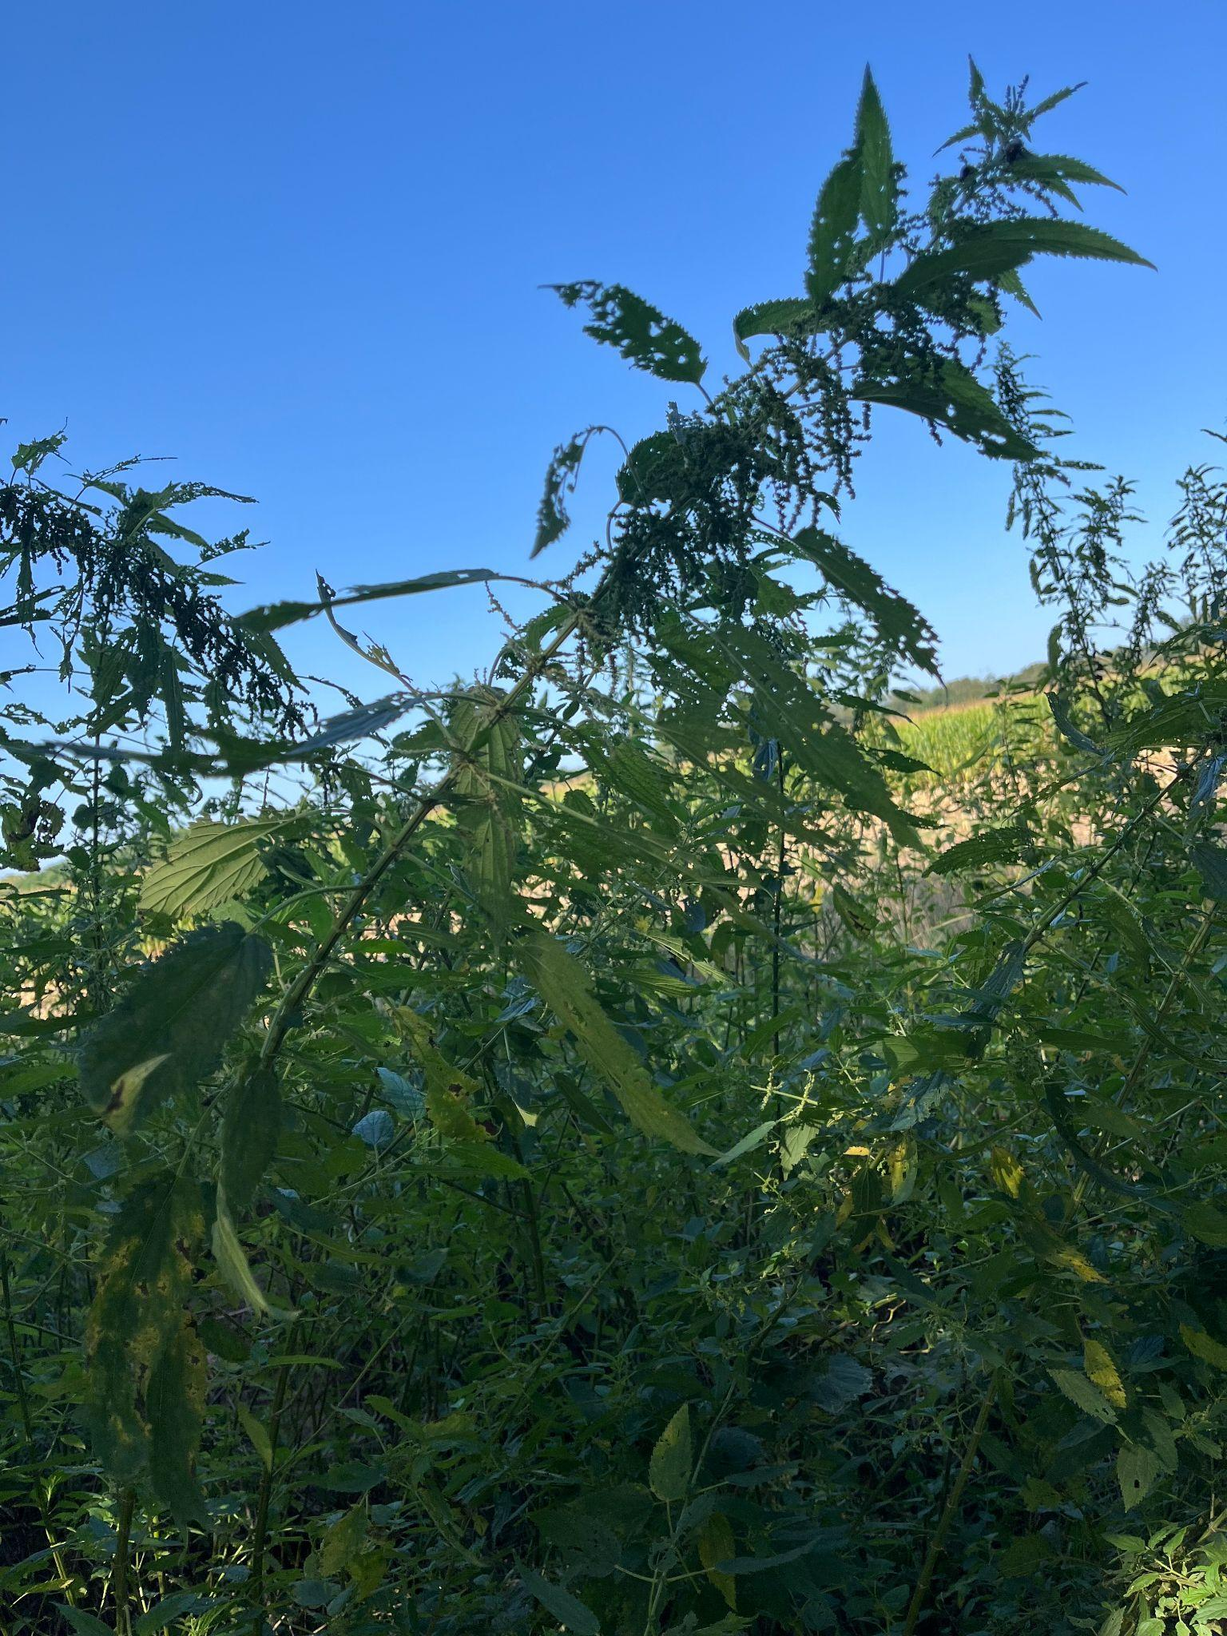
N
Nettles

Slide 16
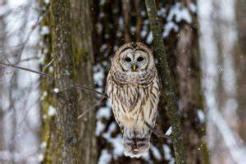
O
Owl

Slide 17
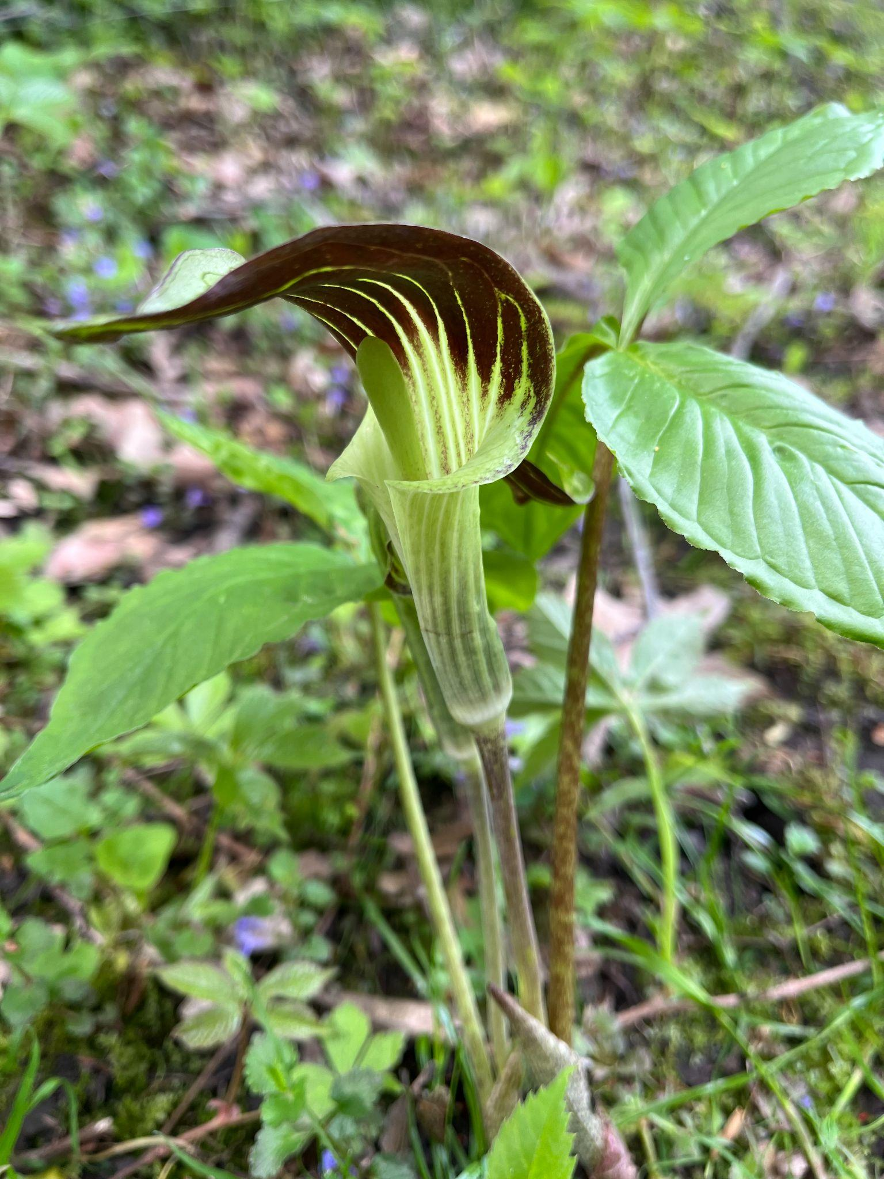
P
Pitcher Plant

Slide 18
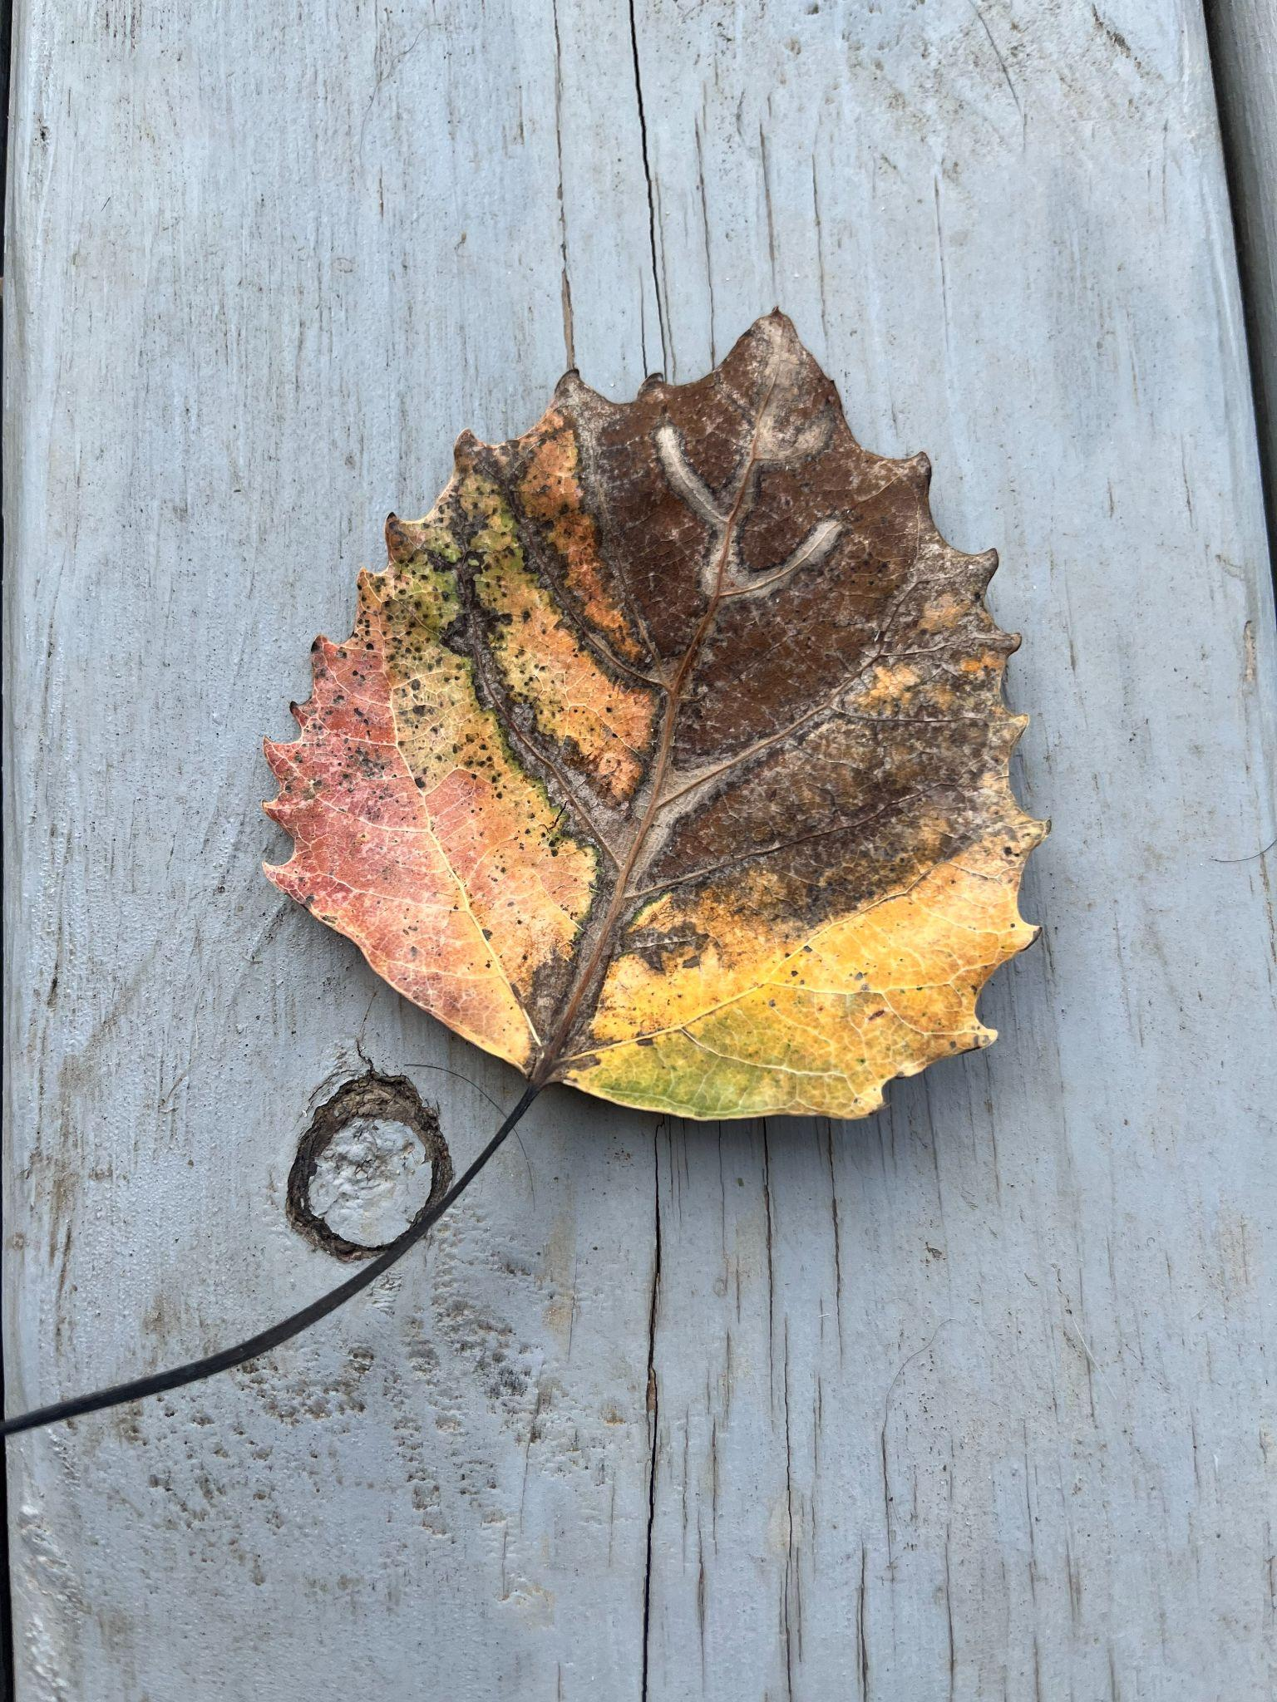
Q
Quaking Aspen

Slide 19
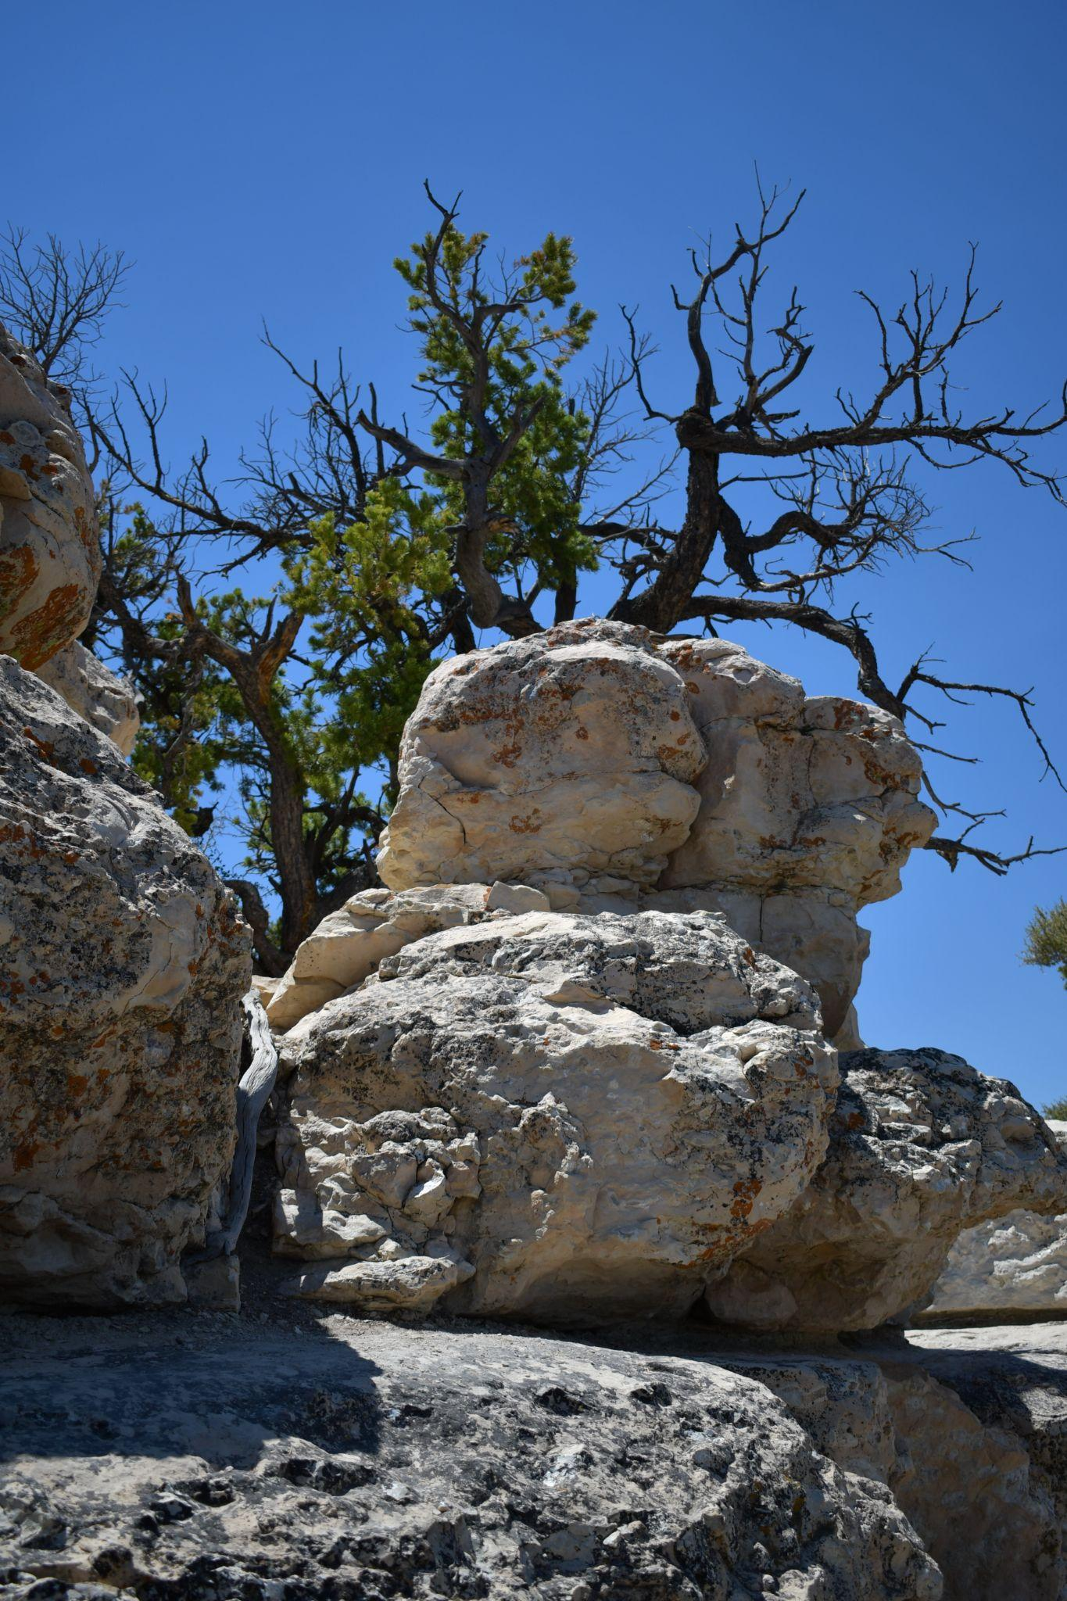
R
Rocks

Slide 20
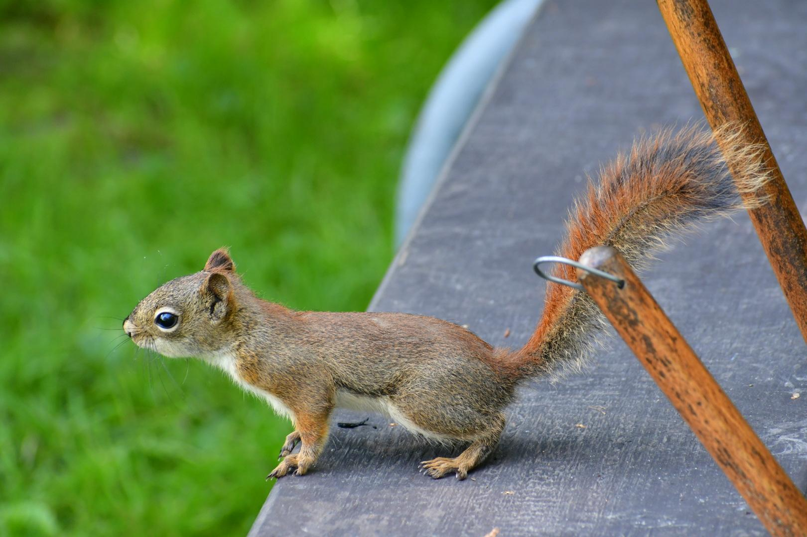
S
Squirrel

Slide 21
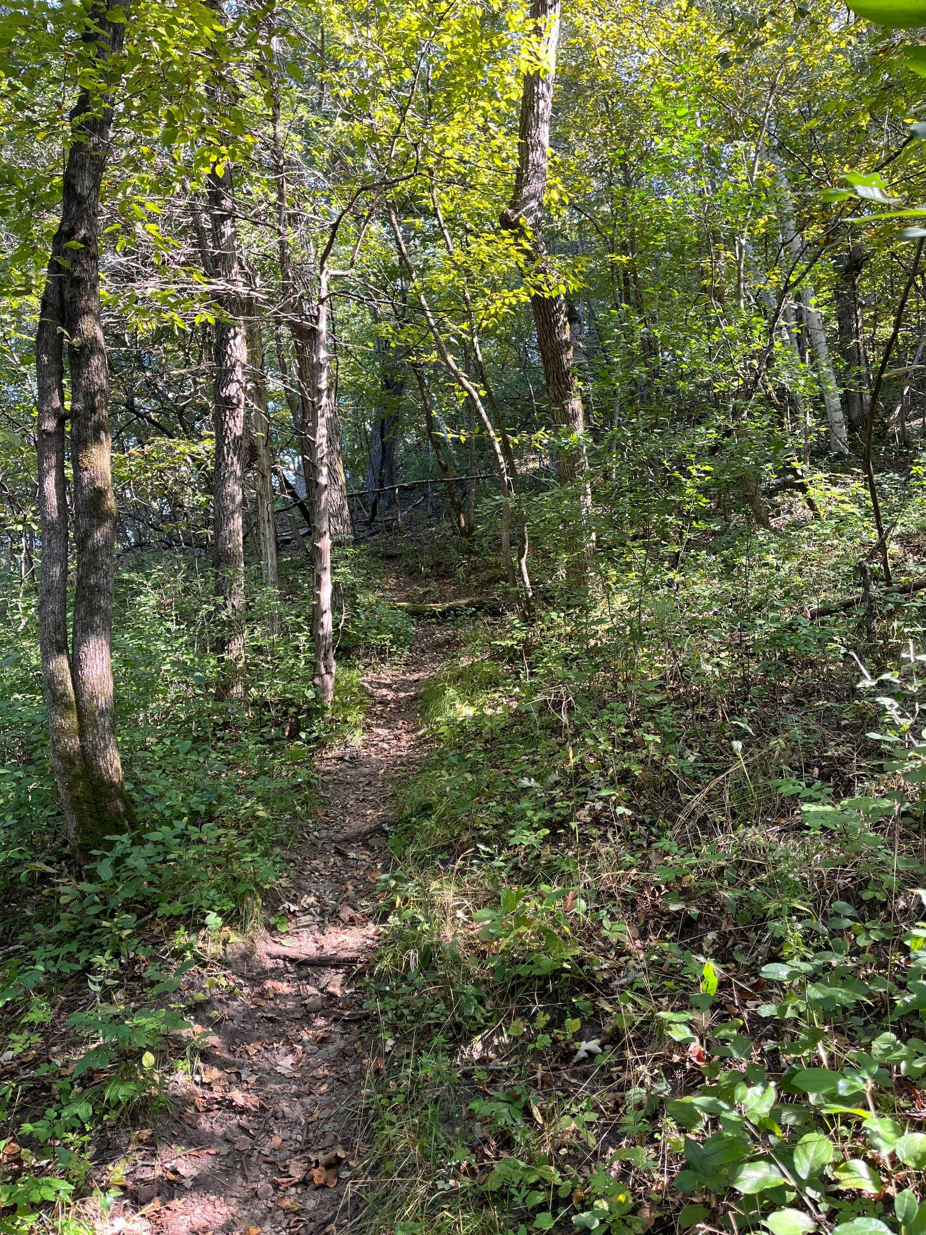
T
Trail

Slide 22
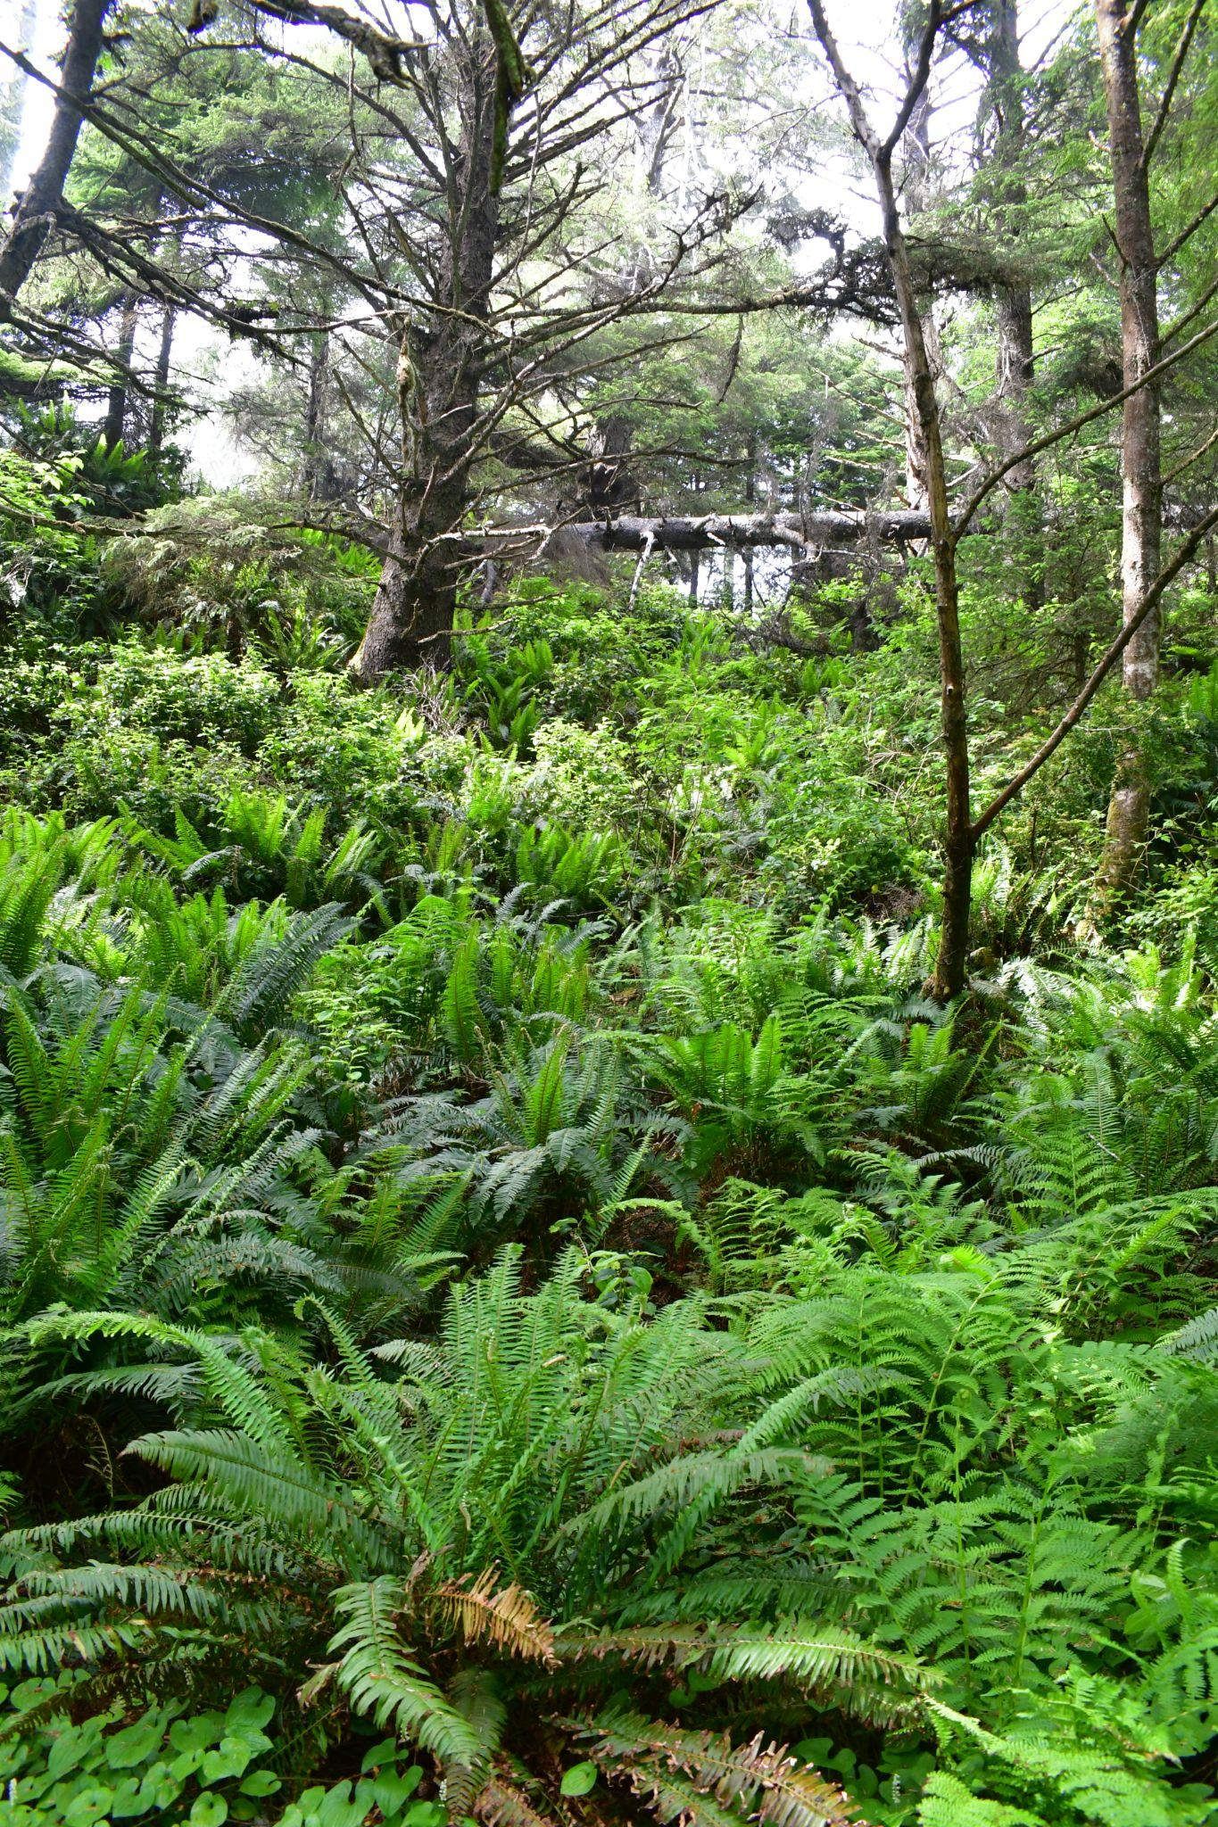
U
Undergrowth

Slide 23
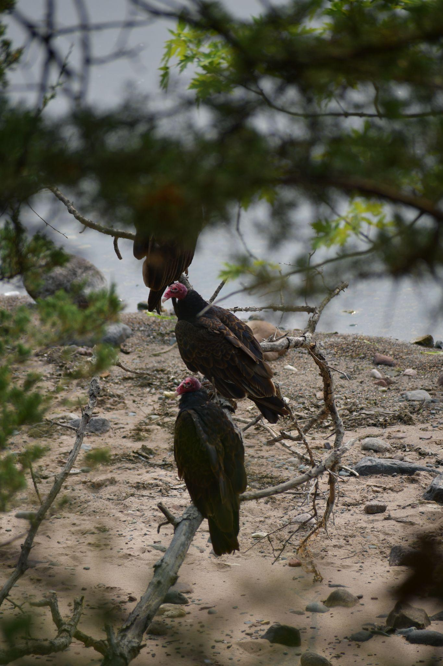
V
Vulture

Slide 24
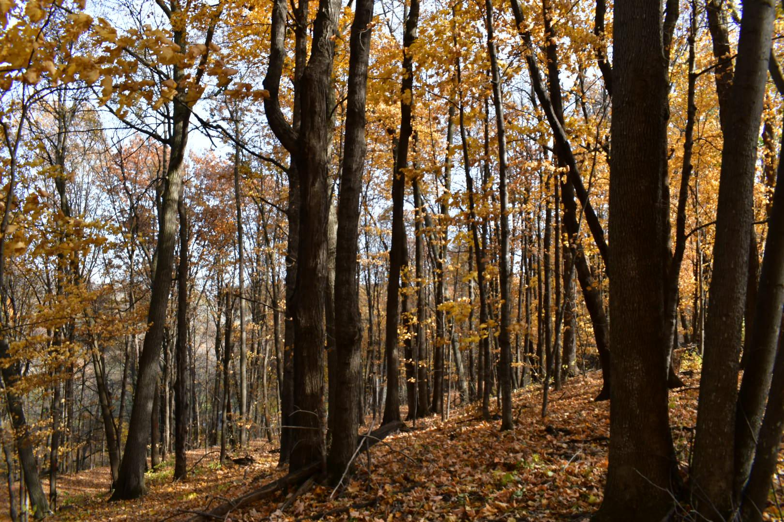
W
Woods

Slide 25
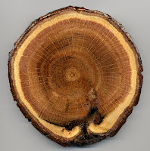
X
Xylem

Slide 26
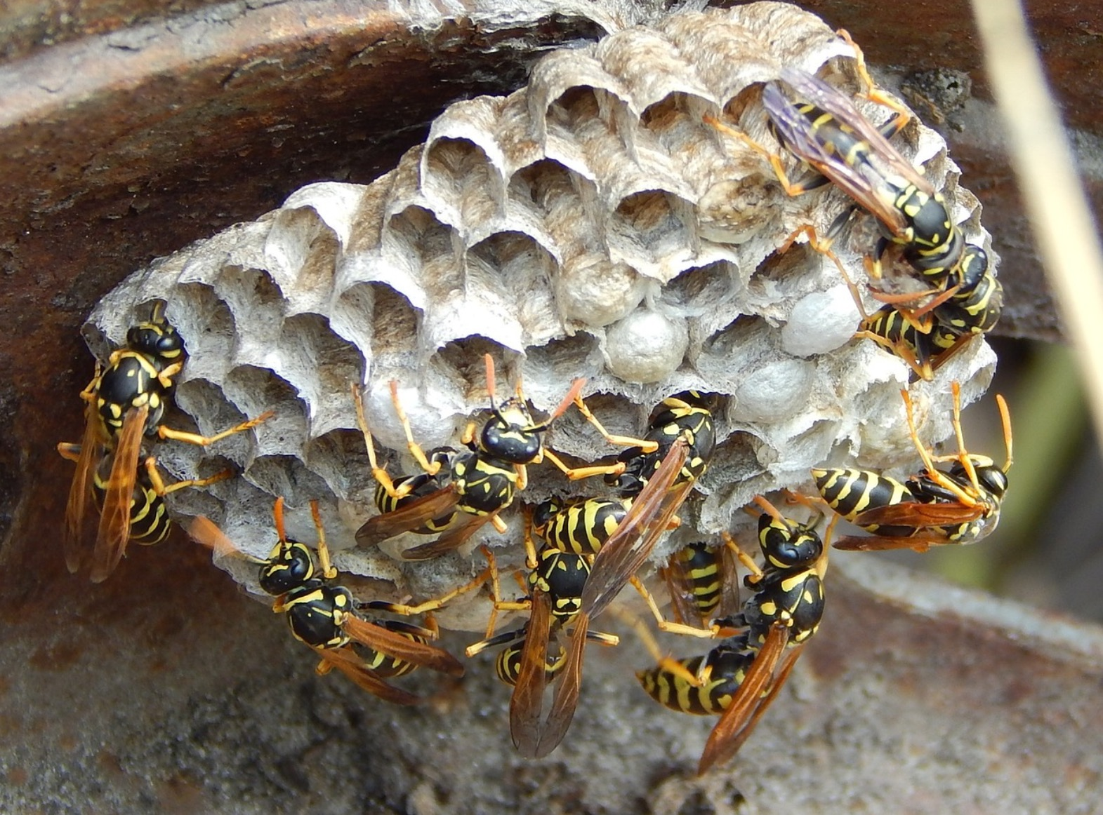
Y
Yellowjacket

Slide 27
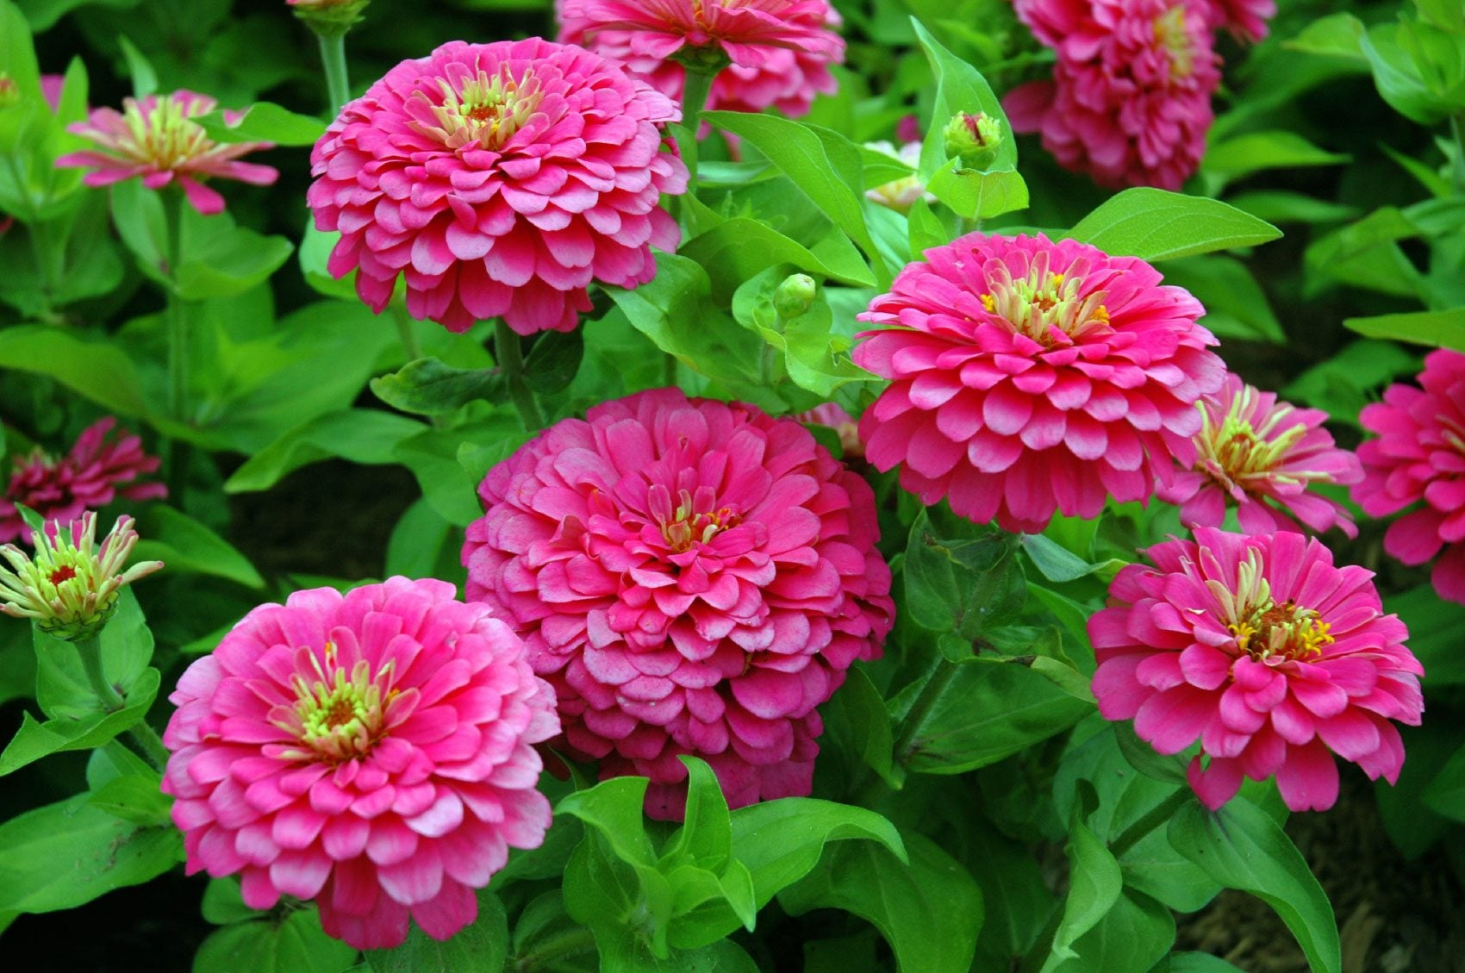
Z
Zinnia

